Slide 1
CSE 486/586 Distributed Systems Reliable Multicast --- 2
Steve Ko
Computer Sciences and Engineering
University at Buffalo

Slide 2
Last Time
How do a group of processes communicate?
Multicast
One-to-many: “Local” broadcast within a group g of processes
What are the issues?
Processes crash (we assume crash-stop)
Messages get delayed
B-multicast
R-Multicast
Properties: integrity, agreement, validity
Ordering
Why do we care about ordering?

Slide 3
Recap: Ordering
Totally ordered messages T₁ and T₂.
FIFO-related messages F₁ and F₂.
Causally related messages C₁ and C₃
Total ordering does not imply causal ordering.
Causal ordering implies FIFO ordering
Causal ordering does not imply total ordering.
Hybrid mode: causal-total ordering, FIFO-total ordering.

Slide 4
Example: FIFO Multicast
(do NOT be confused with vector timestamps)
“Accept” = Deliver
Physical Time
Reject: 1 < 1 + 1
Accept: 2 = 1 + 1
P1
1 0 0
2 0 0
2 1 0
2 1 0
0 0 0
1
2
2
1
1
1
P2
0 0 0
1 0 0
2 0 0
2 1 0
Accept 1 = 0 + 1
1
P3
0 0 0
0 0 0
1 0 0
2 1 0
2 0 0
Accept 1 = 0 + 1
2 0 0
Accept: 1 = 0 + 1
Buffer 2>0 +1
Accept Buffer 2 =1 + 1
0 0 0
Sequence Vector

Slide 5
Totally Ordered Multicast
Using a sequencer
One dedicated “sequencer” that orders all messages
Everyone else follows.
ISIS system
Similar to having a sequencer, but the responsibility is distributed to each sender.

Slide 6
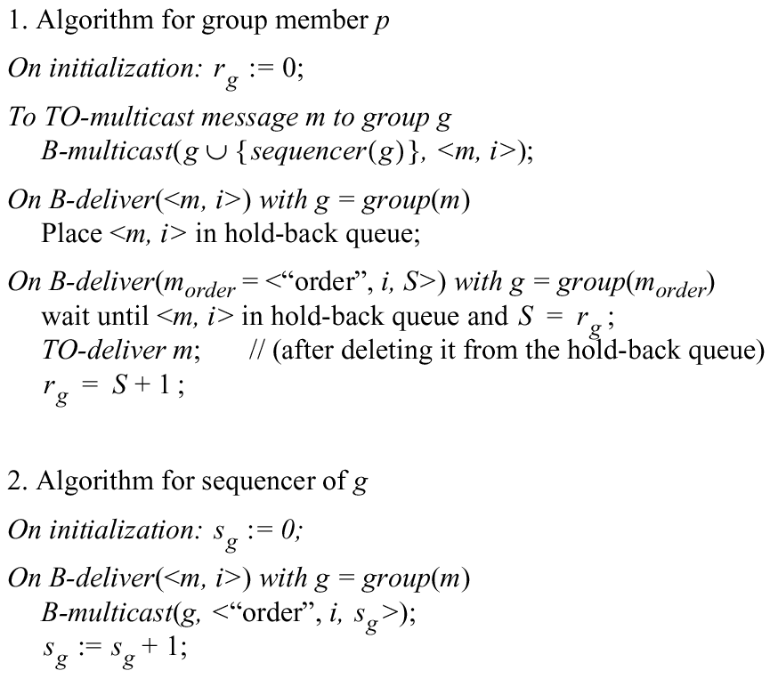
Total Ordering Using a Sequencer
Sequencer = Leader process
i: unique message id

Slide 7
ISIS algorithm for total ordering
P
2
1 Message
3
2
P
2
2 Proposed Seq
4
1
3 Agreed Seq
1
2
P
1
3
P
3

Slide 8

ISIS algorithm for total ordering
Sender multicasts message to everyone
Reply with proposed priority (sequence no.)
Larger than all observed agreed priorities
Larger than any previously proposed (by self) priority
Store message in priority queue
Ordered by priority (proposed or agreed)
Mark message as undeliverable
Sender chooses agreed priority, re-multicasts message with agreed priority
Maximum of all proposed priorities
Upon receiving agreed (final) priority
Mark message as deliverable
Deliver any deliverable messages at the front of priority queue
Notice any (small) issue?

Slide 9
CSE 486/586 Administrivia
Please start PA2 if you haven’t.
AWS codes will be distributed on UBLearns.
Will post setup instructions.
Come talk to me!

Slide 10
Problematic Scenario
Two processes P1 & P2 at their initial state.
P1 sends M1 & P2 sends M2.
P1 receives M1 (its own) and proposes 1. P2 does the same for M2.
P2 receives M1 (P1’s message) and proposes 2. P1 does the same for M2.
P1 picks 2 for M1 & P2 also picks 2 for M2.
Same sequence number for two different msgs.
How do you want to solve this?

Slide 11
Example: ISIS algorithm
Showing the process id only when necessary
A
✔
✔
✔
A:1
A:2
C:2
C:3.3
P1
B:3.1
B:3
C
✔
✔
✔
P2
B:1
B:3.1
A:2
C:3
C:3.3
✔
✔
✔
P3
B:1
B:3
A:2
C:3.3
B:3.1
C:3
B

Slide 12
Proof of Total Order
For a message m₁, consider the first process p that delivers m₁
At p, when message m₁ is at head of priority queue and has been marked deliverable, let m₂ be another message that has not yet been delivered (i.e., is on the same queue or has not been seen yet by p)
finalpriority(m₂) >=
proposedpriority(m₂) >
finalpriority(m₁)
Suppose there is some other process p’ that delivers m₂ before it delivers m₁. Then at p’,
finalpriority(m₁) >=
proposedpriority(m₁) >
finalpriority(m₂)
a contradiction!
Due to “max” operation at sender
Since queue ordered by increasing priority
Due to “max” operation at sender
Since queue ordered by increasing priority

Slide 13
Causally Ordered Multicast
Each process keeps a vector clock.
Each counter represents the number of messages received from each of the other processes.
When multicasting a message, the sender process increments its own counter and attaches its vector clock.
Upon receiving a multicast message, the receiver process waits until it can preserve causal ordering:
It has delivered all the messages from the sender.
It has delivered all the messages that the sender had delivered before the multicast message.

Slide 14
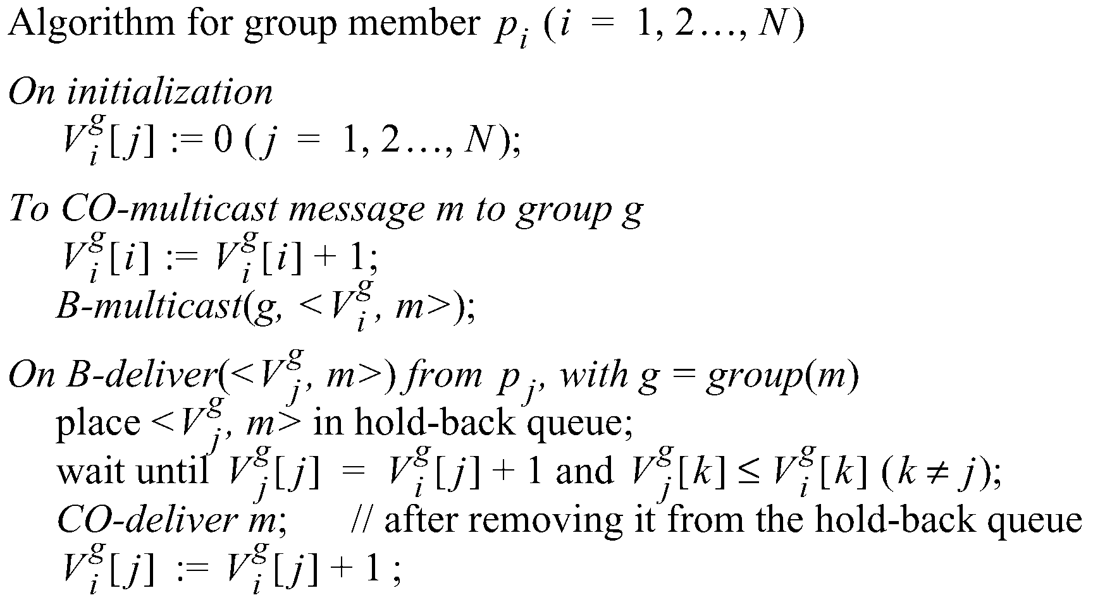
Causal Ordering
The number of group-g messages
from process j that have been seen at
process i so far

Slide 15
Example: Causal Ordering Multicast
Reject:
Accept
P1
1,0,0
1,1,0
1,1,0
0,0,0
(1,0,0)
(1,1,0)
(1,1,0)
P2
0,0,0
1,0,0
1,1,0
(1,1,0)
(1,0,0)
P3
0,0,0
1,0,0
1,1,0
1,1,0
Accept
Accept:
Accept Buffered message
Buffer, missing P1(1)
Physical Time

Slide 16
Summary
Two multicast algorithms for total ordering
Sequencer
ISIS
Multicast for causal ordering
Uses vector timestamps

Slide 17
Acknowledgements
These slides contain material developed and copyrighted by Indranil Gupta (UIUC).

